Slide 1
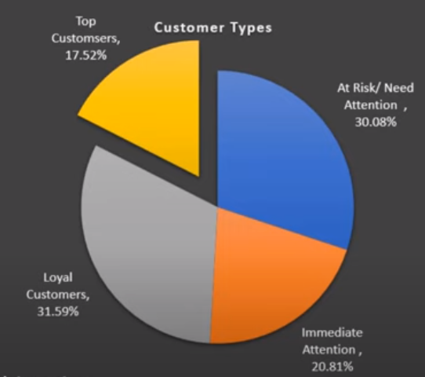
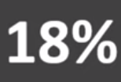
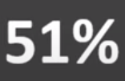
Customer Segmentation
Technique:
By scoring our customers by recency, frequency and revenue, we were able to identify 5 major segments for targeting.
Top Customer Segment:
Our top customers have purchased average 8 times in the evaluation period, spending an average of $7,200 and have purchased within the last 10 days on average.
At Risk & Immediate Attention Segment:
At Risk customers are only spending $353 and have only purchased 3 times in a 150 days.
Recommendation:
We created a target campaign to re-engage our at-risk customers with incentives. Further analyze our top customers/ loyal customers to maximize earnings.

